Slide 1
Project Name
Team Liquid

Slide 2
Project Name
3D Action/RPG
Tower defense element
3rd person view
Click-to-move
Developed for Windows and Mac
Developed in C#
Developed in Unity

Slide 3
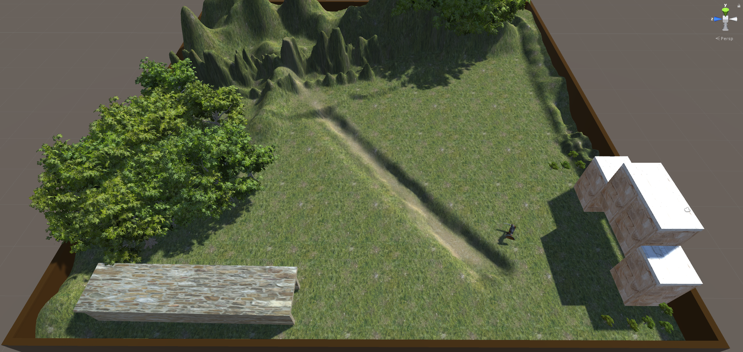
Map – 1 lane

Slide 4
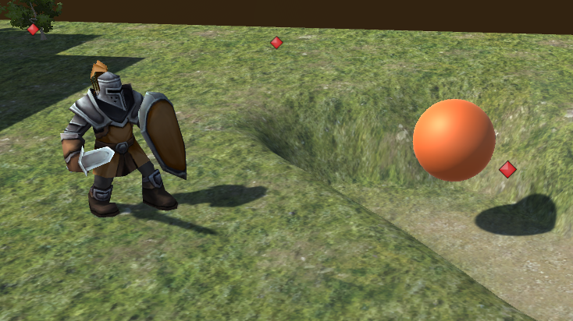
Player and Enemy (stand-ins)

Slide 5
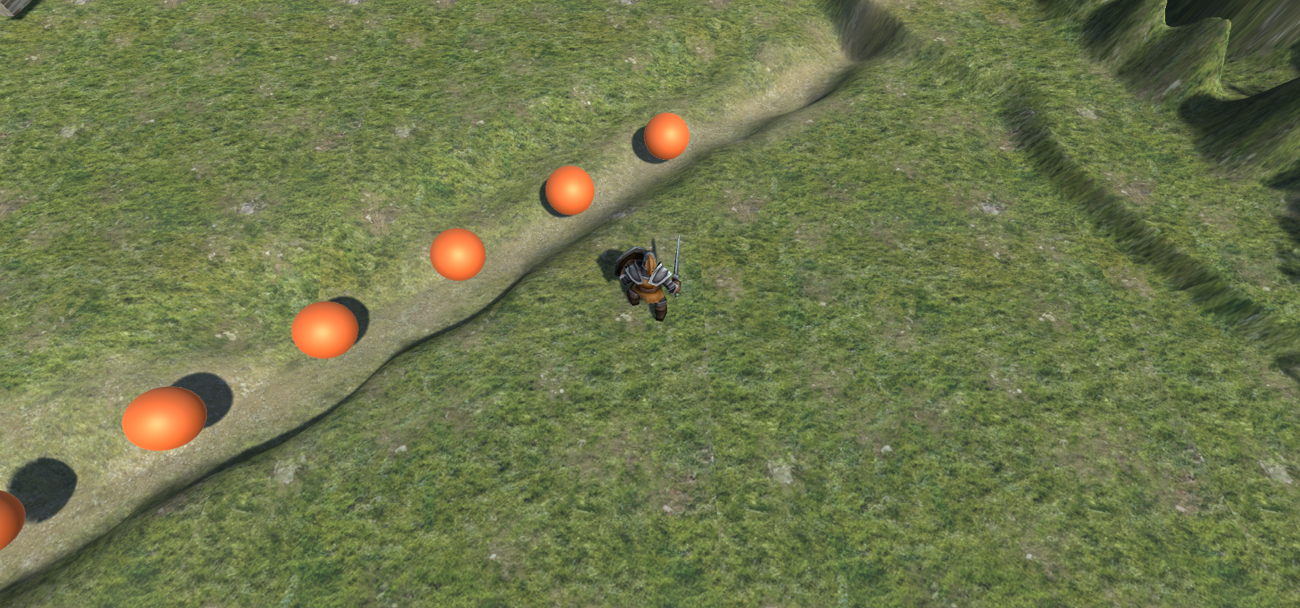
Player POV

Slide 6
Future Features – For Project 3
Player that can attack
Enemies that can die
Wave countdown text
Actual enemy

Slide 7
Future Features – For Project 4
Player that has multiple attacks
Enemies with health bars that deplete on attacks
Different enemies with different amounts of health
Base with health that causes “Game Over” upon depletion
Multiple lanes/spawn points and enemy paths
Mini-map
UI to start and pause game
Time between rounds of waves for towers
Towers

